Slide 1
Lecture 2 Module Design
Last Week :Early design decisions address the system’s architecture
This Week: Later design decisions address how to implement the individual units
Still focusing on Routine Design

Slide 2
Lecture 1 recap
Summary :
Assignment: Task 2-group collaborative design- A slide show (15 minutes)
Design methods:- different decomposition
Architectural Views: different views
Structure of tutorials and Importance of attending
relating decompositions and views to your case study
Forming groups

Slide 3
Module Design
Based on Pfleeger Chapter 6
Design Principles and Methodologies
Design Patterns

Slide 4
6.2 Design Principles
Design principles are guidelines for decomposing a system’s required functionality and behavior into modules
The principles identify the criteria
for decomposing a system
deciding what information to provide (and what to conceal) in the resulting modules
Six dominant principles:
Modularity
Interfaces
Information hiding
Incremental development
Abstraction
Generality

Slide 5
6.2 Design Principles Modularity
Modularity is the principle of keeping separate the various unrelated aspects of a system, so that each aspect can be studied in isolation (also called separation of concerns)
If the principle is applied well, each resulting module will have a single purpose and will be relatively independent of the others
each module will be easy to understand and develop
easier to locate faults (because there are fewer suspect modules per fault)
Easier to change the system (because a change to one module affects relatively few other modules
To determine how well a design separates concerns, we use two concepts that measure module independence: coupling and cohesion

Slide 6
6.2 Design Principles Coupling
Two modules are tightly coupled when they depend a great deal on each other
Loosely coupled modules have some dependence, but their interconnections are weak
Uncoupled modules have no interconnections at all; they are completely unrelated
Uncoupled -
no dependencies
Loosely coupled -
some dependencies
Tightly coupled -
many dependencies

Slide 7
6.2 Design Principles Coupling (continued)
There are many ways that modules can be dependent on each other:
The references made from one module to another
The amount of data passed from one module to another
The amount of control that one module has over the other
Coupling can be measured along a spectrum of dependence

Slide 8
6.2 Design Principles Coupling: Types of Coupling
Content coupling
Common coupling
Control coupling
Stamp coupling
Data coupling
Content coupling
Common coupling
Control coupling
Stamp coupling
Data coupling
Uncoupled
TIGHT COUPLING
LOOSE COUPLING
LOW COUPLING

Slide 9
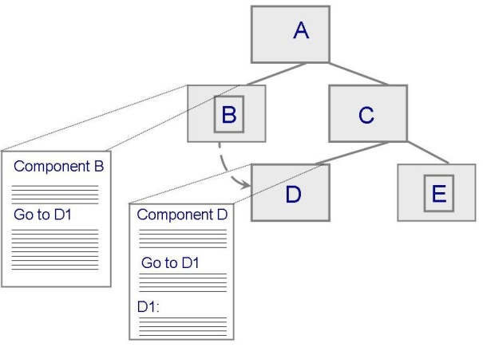
6.2 Design Principles Content Coupling
Occurs when one component modifies an internal data item in another component, or when one component branches into the middle of another component
Module B
_________________
_________________
_________________
_________________
Generate D
Call D
_________________
_________________
_________________
_________________
_________________
_________________
_________________
_________________
Module D
_________________
_________________
_________________
_________________
_________________
_________________
_________________
_________________
_________________
_________________

Slide 10
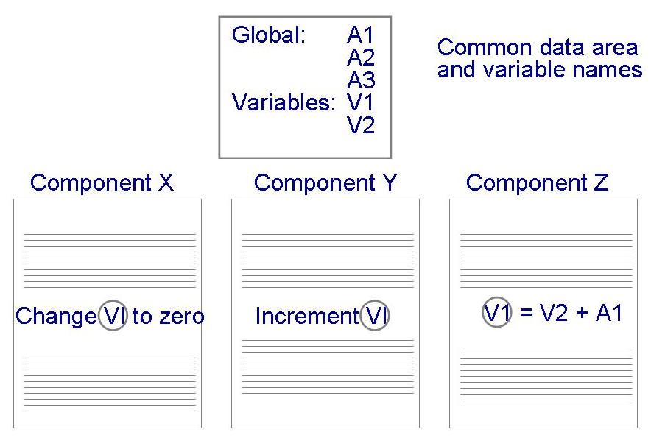
6.2 Design Principles Common Coupling
Making a change to the common data means tracing back to all components that access those data to evaluate the effect of the change

Slide 11
6.2 Design Principles Control Coupling
When one module passes parameters or a return code to control the behavior of another module
It is impossible for the controlled module to function without some direction from the controlling module

Slide 12
6.2 Design Principles Stamp and Data Coupling
Stamp coupling occurs when complex data structures are passed between modules
Stamp coupling represents a more complex interface between modules, because the modules have to agree on the data’s format and organization
If only data values, and not structured data, are passed, then the modules are connected by data coupling
Data coupling is simpler and less likely to be affected by changes in data representation

Slide 13
6.2 Design Principles Cohesion
Cohesion refers to the dependence within and among a module’s internal elements (e.g., data, functions, internal modules)
LOW COHESION
Coincidental
Logical
Temporal
Procedural
Communicational
Functional
Informational
HIGH COHESION

Slide 14
6.2 Design Principles Cohesion (continued)
Coincidental (worst degree)
Parts are unrelated to one another
Logical
Parts are related only by the logic structure of code
Temporal
Module’s data and functions related because they are used at the same time in an execution
Procedural
Similar to temporal, and functions pertain to some related action or purpose

Slide 15
6.2 Design Principles Cohesion (continued)
Communication
Operates on the same data set
Functional (ideal degree)
All elements essential to a single function are contained in one module, and all of the elements are essential to the performance of the function
Informational
Adaption of functional cohesion to data abstraction and object-based design

Slide 16
6.2 Design Principles Interfaces
An interface defines what services the software unit provides to the rest of the system, and how other units can access those services
For example, the interface to an object is the collection of the object’s public operations and the operations’ signatures, which specify each operation’s name, parameters, and possible return values
An interface must also define what the unit requires, in terms of services or assumptions, for it to work correctly
A software unit’s interface describes what the unit requires of its environment, as well as what it provides to its environment

Slide 17
6.2 Design Principles Interfaces (continued)
A software unit may have several interfaces that make different demands on its environment or that offer different levels of service
Module
Data
________________
_________________
_________________
Operation 1
_________________
_________________
_________________
_________________
Operation 2
_________________
_________________
_________________
_________________
Interface A
Operation 1 ()
Operation 2 ()
Operation 4 ()
Operation 3
_________________
_________________
_________________
_________________
Operation 4
_________________
_________________
_________________
_________________
Interface B
Operation 2 ()
Operation 3 ()

Slide 18
6.2 Design Principles Interfaces (continued)
The specification of a software unit’s interface describes the externally visible properties of the software unit
An interface specification should communicate to other system developers everything that they need to know to use our software unit correctly
Purpose
Preconditions (assumptions)
Protocols
Postconditions (visible effects)
Quality attributes

Slide 19
6.2 Design Principles Information Hiding
Information hiding is distinguished by its guidance for decomposing a system:
Each software unit encapsulates a separate design decision that could be changed in the future
Then the interfaces and interface specifications are used to describe each software unit in terms of its externally visible properties
Using this principle, modules may exhibit different kinds of cohesion
A module that hides a data representation may be informationally cohesive
A module that hides an algorithm may be functionally cohesive
A big advantage of information hiding is that the resulting software units are loosely coupled

Slide 20
6.2 Design Principles Incremental Development
Given a design consisting of software units and their interfaces, we can use the information about the units’ dependencies to devise an incremental schedule of development
Start by mapping out the units’ uses relation
relates each software unit to the other software units on which it depends
Uses graphs can help to identify progressively larger subsets of our system that we can implement and test incrementally

Slide 21
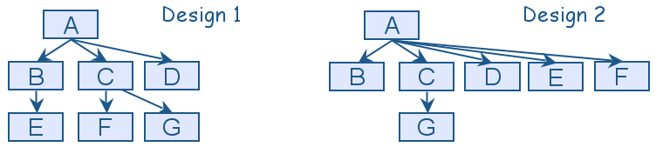
6.2 Design Principles Incremental Development (continued)
Uses graphs for two designs
Fan-in refers to the number of units that use a particular software unit
Fan-out refers to the number of unts used by particular software unit

Slide 22
6.2 Design Principles Abstraction
An abstraction is a model or representation that omits some details so that it can focus on other details
The definition is vague about which details are left out of a model, because different abstractions, built for different purposes, omit different kinds of details

Slide 23
6.2 Design Principles Generality
Generality is the design principle that makes a software unit as universally applicable as possible, to increase the chance that it will be useful in some future system
We make a unit more general by increasing the number of contexts in which can it be used. There are several ways of doing this:
Parameterizing context-specific information
Removing preconditions
Simplifying postconditions

Slide 24
6.2 Design Principles Generality (continued)
The following four procedure interfaces are listed in order of increasing generality:
PROCEDURE SUM: INTEGER;
POSTCONDITION: returns sum of 3 global variables
PROCEDURE SUM (a, b, c: INTEGER): INTEGER;
POSTCONDITION: returns sum of parameters
PROCEDURE SUM (a[]: INTEGER; len: INTEGER): INTEGER
PRECONDITION: 0 <= len <= size of array a
POSTCONDITION: returns sum of elements 1..len in array a
PROCEDURE SUM (a[]: INTEGER): INTEGER
POSTCONDITION: returns sum of elements in array a

Slide 25
Design Patterns
Christopher Alexander described patterns as " (it) describes a problem which occurs over an over again in our environment, and then describes the core of the solution to that problem, in such a way that you can use this solution a million times over, without ever doing it the same way twice".
The intent of each design pattern is to provide a description that enables a designer to determine
whether the pattern is applicable to the current work,
whether the pattern can be reused (hence, saving design time),
whether the pattern can serve as a guide for developing similar, but functionally or structurally different pattern.

Slide 26
6.5 OO Design Patterns
A design pattern codifies design decisions and best practices for solving a particular design problem according to design principles
Design patterns are not the same as software libraries; they are not packaged solutions that can be used as is. Rather, they are templates for a solution that must be modified and adapted for each particular use

Slide 27
6.5 OO Design Patterns Template Method Pattern
The Template Method pattern aims to reduce the amount of duplicate code among subclasses of the same parent class
It is particularly useful when multiple subclasses have similar but not identical implementations of the same method
This pattern addresses this problem by localizing the duplicate code structure in an abstract class from which the subclasses inherit
The abstract class defines a template method that implements the common steps of an operation, and declares abstract primitive operations that represent the variation points

Slide 28
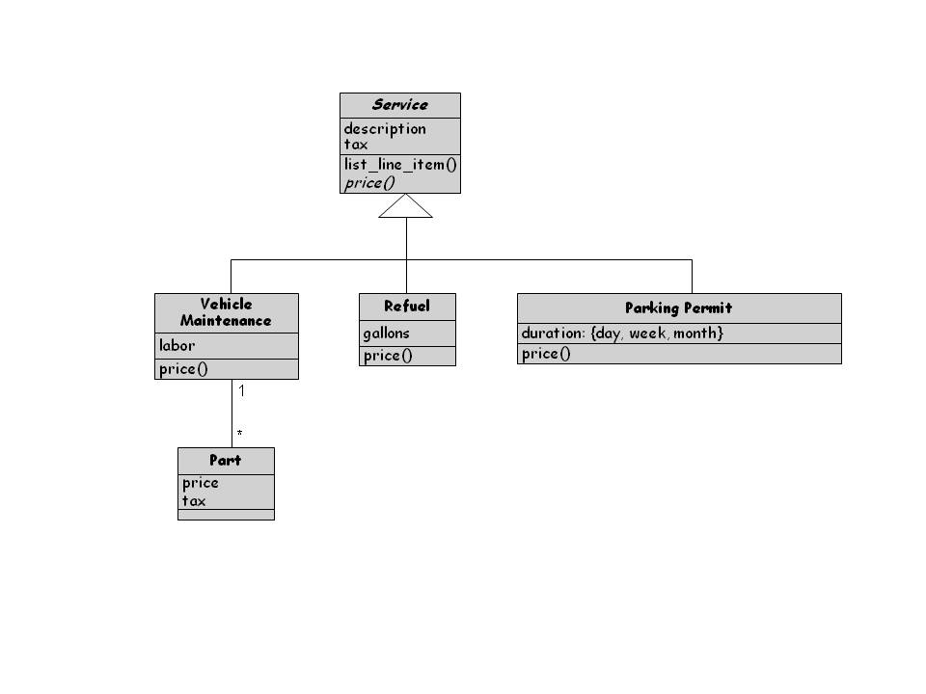
6.5 OO Design Patterns Template Method Pattern (continued)

Slide 29
6.5 OO Design Patterns Factory Method Pattern
The Factory Method pattern is used to encapsulate the code that creates objects
The factory Method pattern is similarto the Template method pattern
The similar but not identical methods are the constructor methods that instantiate objects

Slide 30
Abstract Factory (AF) Design Pattern
Intent
Provide an interface for creating families of related or dependent objects without specifying their concrete classes.
A hierarchy that encapsulates: many possible “platforms”, and the construction of a suite of “products”.
Problem
If an application is to be portable, it needs to encapsulate platform dependencies

Slide 31
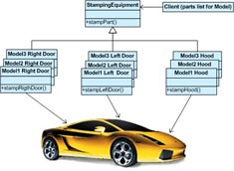
Example of AF Pattern

Slide 32
Example of AF Pattern (cont.)
The stamping equipment is an Abstract Factory which creates auto body parts. The same machinery is used to stamp right hand doors, left hand doors, right front fenders, left front fenders, hoods, etc. for different models of cars.

Slide 33
Flyweight Design Pattern
Intent
Use sharing to support large numbers of fine-grained objects efficiently.
The Motif GUI strategy of replacing heavy-weight widgets with light-weight gadgets.
Problem
Designing objects down to the lowest levels of system “granularity” provides optimal flexibility, but can be unacceptably expensive in terms of performance and memory usage.

Slide 34
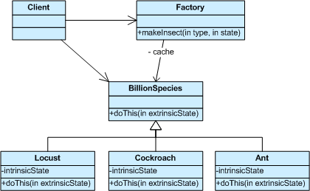
Example of a FlyWeight Design Pattern

Slide 35
Example of a FlyWeight Design Pattern (cont)
The public switched telephone network is an example of a Flyweight. There are several resources such as dial tone generators, ringing generators, and digit receivers that must be shared between all subscribers. A subscriber is unaware of how many resources are in the pool when he or she lifts the handset to make a call. All that matters to subscribers is that a dial tone is provided, digits are received, and the call is completed.

Slide 36
6.5 OO Design Patterns Strategy Pattern
The Strategy pattern allows algorithms to be selected at runtime
It is useful when various algorithms are available to an application but the chose of best algorithm is not known

Slide 37
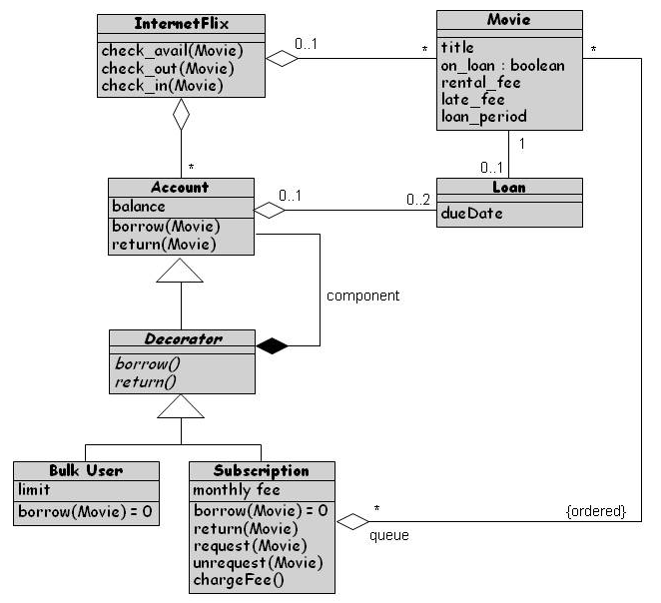
6.5 OO Design Patterns Decorator Pattern
The Decorator pattern is used to extend an object’s functionality at runtime
Decorator pattern is a flexible alternative to using inheritance at design time to create subclasses that support new features

Slide 38
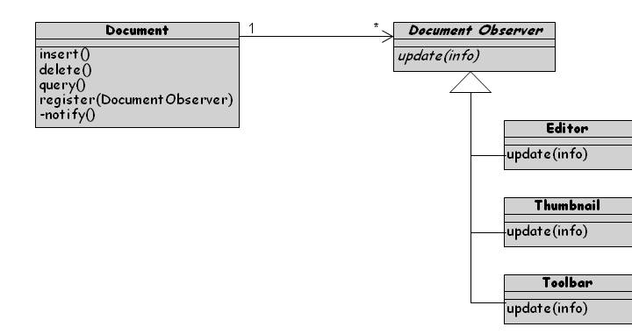
6.5 OO Design Patterns Observer Pattern
The Observer pattern is an application of the publish–subscribe architecture style
Useful when software needs to notify multiple objects of key events

Slide 39
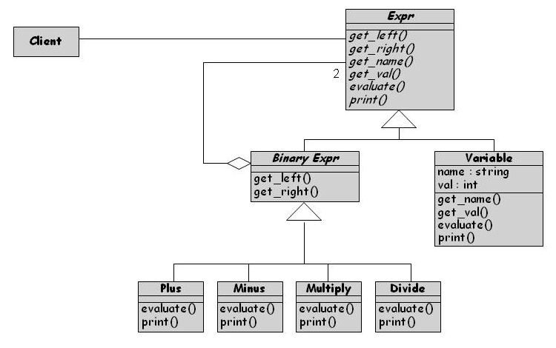
6.5 OO Design Patterns Composite Pattern
A composite object is a heterogeneous, possibly recursive, collection of objects that represents some composite entity
The composite pattern promotes the uses of a single uniform interface

Slide 40
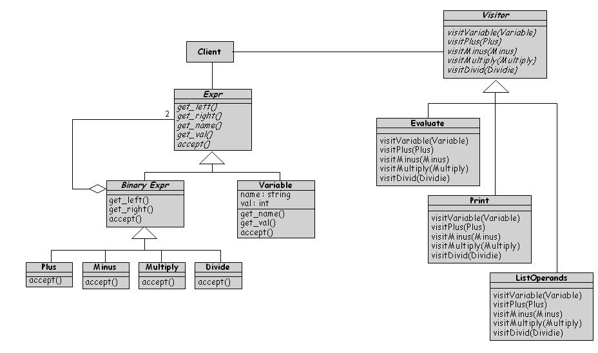
6.5 OO Design Patterns Visitor Pattern
The Visitor pattern collects and encapsulates operation fragments into their own classes
Each operation is implemented as a separate subclass of an abstract Visitor class

Slide 41
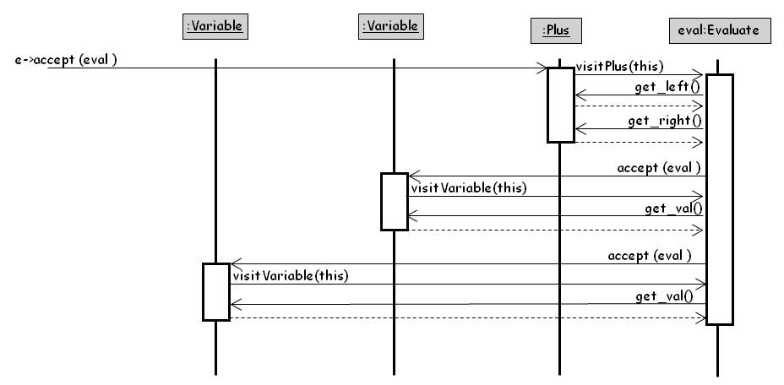
6.5 OO Design Patterns Application of Composite Pattern to Represent Math Expressions

Slide 42
Further Reading

